Slide 1
Training of Trainers
Refresher on presentation & facilitation skills
Group into teams of 3 people (4 teams)
Presentation Practice
  Topics
    UN Reform and Procurement Harmonization Project
    Harmonized UN Procurement Process
      Introduction to UN procurement collaboration
      Enablers
      Options
      Institutionalization
  45 mins + Q & A
  Reflection & Feedback
  No Powerpoint

Slide 2

PRESENTATIONS
Set a theme
Provide outline
Demonstrate enthusiasm
Sell an experience
Make numbers meaningful
Use visuals
Strong opening & conclusion
Rehearse, rehearse, rehearse

Slide 3
Facilitating Group Discussions

Slide 4
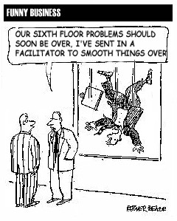

Slide 5
Presentation Skills

Slide 6
4 Key Aspects
Voice
Language
Body Language
Visual

Slide 7
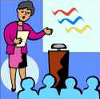
Speed
Effective speakers change their rate of speed to fit their purpose, content, listeners & personal style

Slide 8
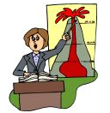
Tone
emphasis placed on a word to create meaning
variation prevents monotonous presentations

Slide 9
Volume / Variety / Vocabulary
project your voice
  - aim for the back
go faster to excite
to gain maximum attention, say some words louder
repeat important words

Slide 10
Volume / Variety / Vocabulary
go s l o w e r to emphasize major points
give emphasis with voice & body
pause often & look round audience

Slide 11
Language
avoid…
acronyms
being too formal
long sentences
try to…
use everyday language
use concrete words

Slide 12
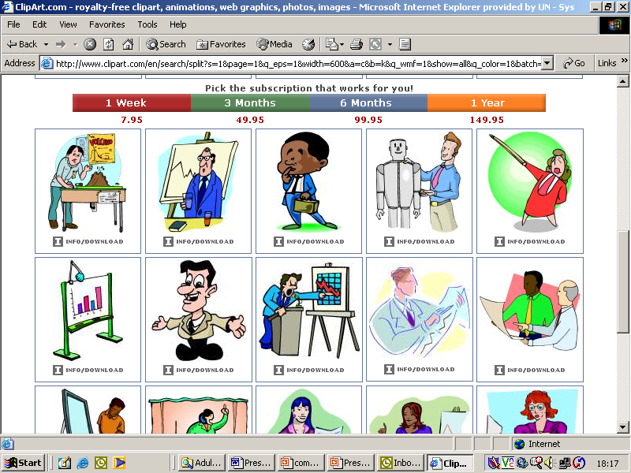
Body Language – Don’ts
don’t point at anyone
don’t move while presenting key points
don’t stand rooted to the spot
don’t leave your hands by your sides
don’t avoid eye contact

Slide 13
Body Language - Dos
move hands & arms
move around the room
move towards audience
move your eyes around the audience

Slide 14
What are the characteristics of effective facilitators?
5 big post-its per table
10 minutes

Slide 15
What is a facilitator?
Literally means: ‘making things easy’
A person who helps a group or team to:
  Achieve results in interactive events
  By using a range of skills and methods
  To bring the best out in people as they work together
  Focus on the process of how

Slide 16
Role: Conductor

Slide 17
Role: Impartial Helper
belonging to no political coalition within an organisation
being seen as having no stake in the outcomes

Slide 18
What a facilitator is NOT
participant in the team
team leader
team organiser/administrator,
negotiator on the team’s behalf,
servant who simply does the bidding of the team
expert trainer

Slide 19
Facilitator’s Role: Overview
cope with uncertainty
be calm in times of emotion
support and counsel others
empathise
be understandable
mobilise energy
surface difficult issues and help others to do so
take themselves less seriously

Slide 20
What are the challenges of facilitating groups?
5 big post-its per table
10 minutes

Slide 21
Facilitating Meetings
Eleven million meetings every day in USA
Most professionals attend 61.8 meetings a month
People report that over 50% of their meeting time is wasted

Slide 22
Facilitating Meetings
Get the right people in the room
Control what you can, let go what you can’t
Explore the whole elephant
Let people be responsible
Find common ground
Use subgrouping

Slide 23
Questioning
Use O P E N to probe:
“Who, why, what, when, how?”
Use CLOSED (yes/no answers)
to redirect/ summarise:
“Are you saying that…?”

Slide 24
Questioning
Use YOU questions
How do you see this?
What are your priorities?
How important is ...... to you?
Tell me more about ......?
What if.......Why........How......?

Slide 25
Good Facilitation Brings
Co-operation
Results

Slide 26
Training of Trainers
Refresher on presentation & facilitation skills
Group into teams of 3 people (4 teams)
Presentation Practice
  Topics
    UN Reform and Procurement Harmonization Project
    Harmonized UN Procurement Process
      Introduction to UN procurement collaboration
      Enablers
      Options
      Institutionalization
  45 mins + Q & A
  Reflection & Feedback
  No Powerpoint

Slide 27
Presentation & Facilitation Feedback
1. Presentation skills (voice, language, body language, visuals, use of space, clarity of message and ideas)
2 Managing time and session flow (staying with the purpose of the session, keeping a task-related focus)
3. Engaging the whole group and ensuring group understanding (repeating questions for the whole group, listening skills, paraphrases, giving opportunity for quieter pax to participate)

