Slide 1

Harmonization and Simplification of UN Business Operations

Slide 2
QCPR and Business Operations
11 mandates for H-BO
QCPR 2013-2016- Business Operations
Increased use of national public and private systems
Common and standardized system of cost control
Greater collaboration in procurement
Decision power delegated to OMT
Consolidation of support services
Redirect efficiency savings into programmes
Funding mechanisms for innovation
Prioritize the availability of financial and human resources
Establishment of common premises
Reduce the nr. of parallel project implementation units
(Feasibility Study) ERP Interoperability
Notes:
Key Message- There are 11 different mandates provided through the QCPR (pick the mandate that fits the message of the presentation/audience)
QCPR Mandates relevant to Business Operations
152. Requests the United Nations development system funds and programmes, and encourages the specialized agencies and other entities of the United Nations, to further pursue higher-quality, more effective and cost-efficient support services in all programme countries by reducing the duplication of functions, and administrative and transaction costs through the consolidation of support services at the country level, either by delegating common functions to a lead agency, establishing a common United Nations service centre or, where feasible, outsourcing support services without compromising quality of services, and, within their mandates, ensuring that efficiency savings are used for programme activities with a view to building national capacities, and to report on concrete achievements in this regard to their respective governing bodies by the end of 2014 and annually thereafter, and requests the funds and programmes to submit a joint plan in this regard to their executive boards at their first regular sessions in 2014;
153. Also requests the funds and programmes, and encourages the specialized agencies and other entities of the United Nations, to further invest in intra-agency rationalization of business operations and to present plans in this regard to their governing bodies by the end of 2013;
154. Further requests the funds and programmes, and encourages the specialized agencies and other entities of the United Nations system, to develop and conclude inter-agency framework agreements regarding the provision of support services regulating the mutual validity of agreements between United Nations entities and third parties at the country level and to delegate the authority to country teams to establish and manage common services and long-term agreements with third parties through standardized inter-agency agreements without further approval requirements by the end of 2013;
155. Requests the Secretary-General through the High-level Committee on Management and the United Nations Development Group to present plans for the establishment of common support services at the country, regional and headquarters levels, based on a unified set of regulations and rules, policies and procedures, at the country, regional and headquarters levels, in the functional areas of finance, human resources management, procurement, information technology management and other administrative services, for review by the Economic and Social Council and approval by the executive boards of the funds and programmes and the governing bodies of the specialized agencies by end of 2014, with a view to implementation by 2016;
156. Recognizes that more cost-effective, efficient and harmonized procurement practices can help to achieve greater effectiveness and better results, encourages the United Nations development system to consider options for greater collaboration in procurement at the country, regional and global levels, taking into account the United Nations procurement principles of, inter alia, fairness, integrity, transparency and effective international competition, and in this regard requests the funds and programmes, and encourages the specialized agencies and other entities of the United Nations system, to address the barriers to greater procurement cooperation and to fully exploit the potential for improved efficiency and effectiveness through increased collaboration, and to redirect efficiency savings, including from economies of scale, into programmes, and to make full use of the existing long-term agreements, develop new ones and implement the guidelines on common procurement at the country level;
157. Encourages the United Nations development system, in compliance with existing relevant legislative frameworks, to make increased use of national public and private systems for support services, including for procurement, security, information technology, telecommunications, travel and banking, as well as, when appropriate, for planning, reporting and evaluation;
158. Also encourages the United Nations development system to avoid and significantly reduce the number of its parallel project implementation units in programme countries as a means of strengthening national capacities and reducing transaction costs;
159. Requests the Secretary-General to present to the executive boards of the funds and programmes, by the beginning of 2014, a proposal on the common definition of operating costs and a common and standardized system of cost control, paying due attention to their different business models, with a view to their taking a decision on this issue;
160. Requests the funds and programmes, and encourages the specialized agencies and other entities of the United Nations development system, to consider system-wide interoperability of enterprise resources planning systems, with the objective of harmonizing the electronic processing of internal and external management information, supporting harmonized business processes and practices across the entire United Nations development system in all future investments related to existing or new enterprise resources planning systems, and in this regard requests the Secretary-General to undertake a study to examine the feasibility of establishing interoperability among the existing enterprise resources planning systems of the funds and programmes and to report on progress in achieving full interoperability in 2016 in the context of the quadrennial comprehensive policy review;
161. Requests the United Nations development system to develop a strategy, in consultation with Member States, by the end of 2013, with concrete goals and targets, to support the establishment of common premises in programme countries that wish to adopt them, with due consideration to security conditions as well as cost-effectiveness, and to report on progress in this regard to the Economic and Social Council on a biennial basis, and encourages United Nations country teams to explore all potential savings across the organizations, including the harmonization of business practices in all functional areas and the consolidation of support services;
162. Also requests the United Nations development system to prioritize the availability of financial and human resources, without compromising the allocation of resources to programmatic activities, to further support the effective harmonization and rationalization of business operations, including the option of developing funding mechanisms and other incentives in support of innovative and sustainable business solutions supporting the further development and implementation of high-quality, efficient and cost-effective common support services;
163. Strongly encourages the governing bodies of the specialized agencies and other relevant United Nations entities to review and discuss the provisions in this subsection with a view to promoting their implementation by the respective entities and improving harmonization with funds and programmes;

Slide 3
Operationalization QCPR
SOPs to be established for the second generation of DaO countries:
  Development of DaO specific guidance by the UNDG Working Mechanisms in collaboration with the HLCM Networks where relevant.
  Dissemination of the SOPs, training and capacity building for the roll-out of the second generation of Delivering as One.

Slide 4
SoPs for DaO
Joint National/UN Steering Committee
One Leader (RC and UNCT)
Result Groups
OMT
Country CG
One Programme
Common Budgetary Framework
+ One UN Fund
Operating as One
Commun-icating as One
One annual UN Country Results Report (programme, funding, operations, communications)

Slide 5
HLCM-UNDG and the BOS
HLCM
Harmonised BO policies, procedures
Proc
ICT
HR
FIN
…
Data, Policy Input
UNDG
Country level solutions
BOS
UNCT
UNCT
UNCT
UNCT
UNCT
UNCT
UNCT
Notes:
The BoS operationalizes HLCM/UNDG harmonized policies, rules and regulations and “translates” these into country level solutions. As such it is the conduit for HLCM/UNDG to roll-out the newest innovations and changes in BO at the country level.
Added value BoS country level:
Reduced cost
Enhanced quality and access to services that would not be possible if agencies would develop these services just for themselves
State of the art Common Services based on the latest HLCM and UNDG products
Added value BoS for HLCM/UNDG/HQ
- vehicle to gather data and management information on impact and issues, bottlenecks at the country level that need to inform further harmonization and policy dialogue at UNDG,HLCM and agency HQ level.
- conduit for HLCM/UNDG to roll-out the newest innovations and changes in BO at the country level.

Slide 6
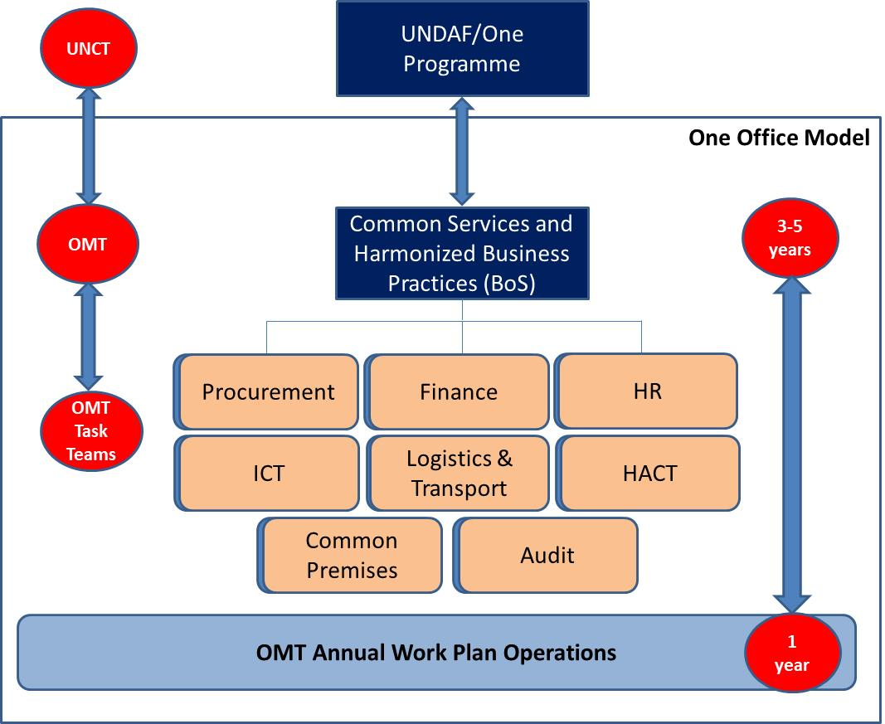
What is the BOS?
BoS = Scalable- Pick and chose service lines as locally needed

Slide 7
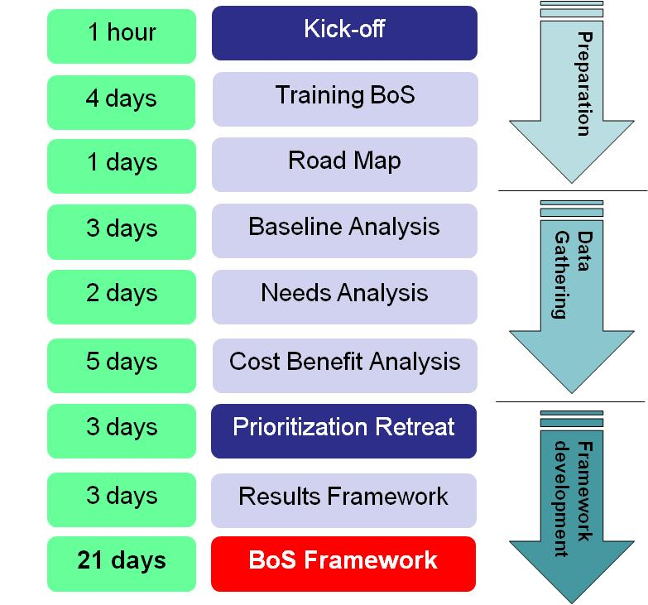
Milestones BoS development
1 hour
4 days
2 weeks
Average Time
3 weeks
2 weeks
4 weeks
3 days
2 weeks
2 weeks
Notes:
The graphic show a “regular BoS approach. Actual time varies depending on the scope of the BoS.

Slide 8
What is the BOS ?
Derives partially from UNDAF/One Programme:
Voluntary instrument to be used at the country at level by UNCTs/OMTs;
Developed in conjunction with the UNDAF;
Covers Joint Business Operations initiatives;
Provides strategic, medium term focus, same cycle as the UNDAF;
Provides the basis for Monitoring, Evaluation and Reporting of Business Operations- harmonized framework;
Provides the basis for BO Budgetary Framework and Resource Mobilization.
Notes:
Key message: What is the BoS and what is it not. Stress the BoS will not replace agency operations, but rather complement agency business operations with those operations that are done jointly.
When explaining what the BoS is, draw the parallel to an “UNDAF for Business Operations”, but lighter in approach. Highlight it is based on the same RBM principles as the UNDAF (logframe, outcomes, outputs, indicators).
Components of the BoS:
Business Operations Results Framework, reflecting medium term outcomes and outputs in line with the UNDAF cycle;
Monitoring and Evaluation Framework, reflecting outcome and output level indicators allowing for progress monitoring and evaluation of impact of business operations;
Management Arrangements of UN Business Operations outlining the way the UN organizes itself in order to deliver cost effective operational support that meets UN Programme requirements;

Slide 9
Why do the BOS?
Enhanced linkages Programmes and Operations
Reduced Costs
  Reduction of duplication of work processes;
  Reduction of transaction costs;
Enhanced Quality of Business Operations;
Enhanced operational focus and prioritization of investment in Business Operations.
Enhanced ability to track and report on results beyond a single year- enhanced Management Information
Notes:
Key message: what are the intended results of the BoS.
Stress the enhanced linkage programmes and operations, which addresses a persistent issue with programmes and operations operating in silo’s at the country level.
Stress the potential to reduce cost of operations, something that the UN System is under heavy pressure for to do. Cost reduction examples include enhanced bargaining position and quantum discounts (larger volumes) and elimination of repetitive processes by executing together (saving labor time)
Enhanced linkages Programmes and Operations: The BoS has two components of operational support services - those deriving from UNDAF/programme and “ongoing operations” that do not derive directly from the programme. By analyzing the programme strategy through an operational lens and identifying the operations required to deliver the programme, the linkages between programme and operations are established. As both the UN Programme Strategy (UNDAF) and the Business Operations Strategy are on the same cycle, the development of the Business Operations Strategy enhances the linkages between the UNDAF and UN operations support to that programme strategy;
Reduced Costs: The BoS provides a strategic focus on operational support services and initiatives aimed at harmonizing and/or simplifying business operations. It allows for multi-year planning of operations and facilitates strategic planning of the operational effort. The suite of operational instruments it comes with allow for enhanced identification of cost benefits of different initiatives, allowing facts based decision making and prioritization. It also facilitates monitoring and evaluation of the operational effort at the country level. It focuses on reduced lead times to execute processes through streamlining operational process, and reduced direct monetary cost for example by leveraging UN System wide bargaining position when procuring goods and services. Anticipated cost reductions include:
Reduction of duplication of work processes at the agency level by providing the service through a single channel, rather than decentralized at the agency level (example ICT, Travel and building maintenance);
Reduction of transaction costs (time spent on activities) for the UN and partners, including the host government, due to harmonized operational procedures and standing agreements with vendors (e.g. VISA processes and Joint Long Term Agreements);
Enhanced leverage of UN bargaining position when procuring goods in larger quantities (ex. Office bulk goods, printing services).
Enhanced Quality: By jointly procuring services in larger volumes, the UN increases it bargaining power with the service provider and enhances its ability to monitor and evaluate overall quality of service delivery of that service provider.
Enhanced Operational Focus and prioritization: Instruments like Cost Benefit Analysis, Transaction Cost Analysis and Business Process Analysis provide light, easy to use tools to identify and prioritize high impact harmonization initiatives and facilitating monitoring and evaluation of harmonization initiatives against pre-established baselines.

Slide 10
Scoping the BoS
Flexibility- based on in country capacity and need, the UNCT/OMT can select multiple or just one outcome area (ex. Procurement);
Time Requirement: 6-8 weeks end-to-end over a 5 year cycle to develop the BoS, including analysis;
Time requirement may be higher or lower depending on the scope of the BoS (depends on capacity available and need).

Slide 11
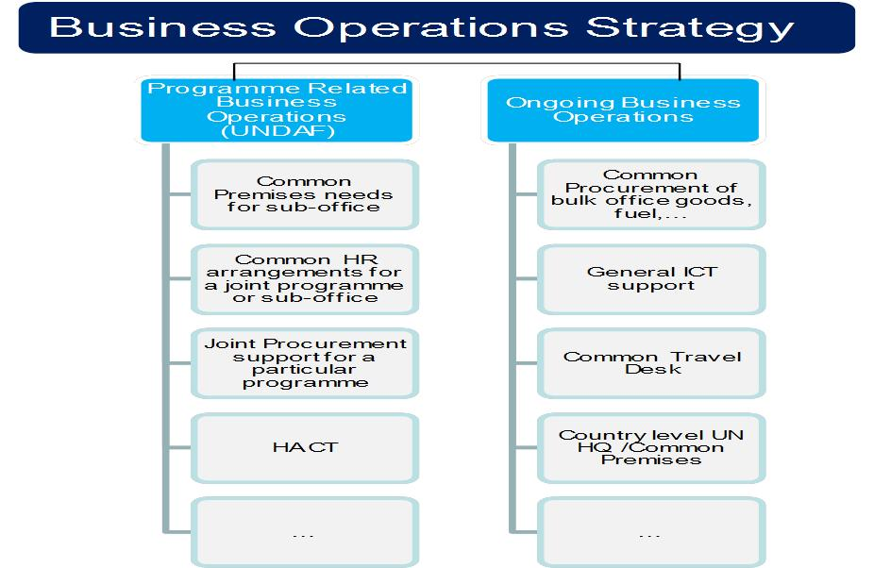
Link BOS- Programmes

Slide 12
BoS pilots (2013)
14 pilots, X self starters
LIC countries, MIC and Post Conflict Countries
Support UNDG and HLCM- Technical, QA, Mission, Political
Notes:
Key message: BoS is piloted to test it and see whether it works as intended at the country level. The results of the pilot will trigger a review of the model to ensure it fits exactly with country level possibilities and constraints. Due to the varied range of pilot countries, the BoS will match a diverse range of needs and constraints.

Slide 13
BOS pilot Status- Sept 2014
BoS Pilot Status September 2014
Completed | On Track | Withdrew
8 | 4 | 2

Slide 14
BOS pilot Status- Detailed
On Track (5)
Cancelled (2)
BOS completed (7)
  Ethiopia
  Jamaica
  Lesotho
  Malawi
  Moldova
  Rwanda
  Tanzania
  Bosnia Herzegovina
  Brazil
  Estimated completion: Dec 2014
  South Africa
  Estimated completion: Dec 2014
  Liberia
  Estimated completion: Dec 2014
  Denmark (Copenhagen)
  Estimated completion:Q1 2015
  Iraq
  (due to local dynamics- civil unrest)
  Afghanistan
  (due to local dynamics- civil unrest)

Slide 15
BO areas under the BOS

Slide 16
BOS pilots per region

