Slide 1

Business Operations: The Engine of the UN

Slide 2
The future: Post 2015 and Business Ops
Operational Excellence
Partnerships
Data Revolution
Business Operations
Programme
Notes:
Message: The Post 2015/SDG agenda will significant implications for Business Operations
Impact can be divided over two broad roles of Business Operations in the Post 2015:
“Business Operations as an enabler” for many of the changes, for example creating an ICT environment that can handle and support the increased data analytics and civic engagement
The implications for Business Operations as a participant- changes in the different areas of business operations to meet the new demands under the Post 2015 agenda. For example, defining what partnerships would add value to enhanced Business Operations, what data do we need to enhance Business Operations performance etc.

Slide 3
QCPR and Business Operations
11 mandates for H-BO
QCPR 2013-2016- Business Operations
Increased use of national public and private systems
Common and standardized system of cost control
Greater collaboration in procurement
Decision power delegated to OMT
Consolidation of support services
Redirect efficiency savings into programmes
Funding mechanisms for innovation
Prioritize the availability of financial and human resources
Establishment of common premises
Reduce the nr. of parallel project implementation units
(Feasibility Study) ERP Interoperability
Notes:
Message- There are 11 different mandates provided through the QCPR (pick the mandate that fits the message of the presentation/audience)
QCPR Mandates relevant to Business Operations
152. Requests the United Nations development system funds and programmes, and encourages the specialized agencies and other entities of the United Nations, to further pursue higher-quality, more effective and cost-efficient support services in all programme countries by reducing the duplication of functions, and administrative and transaction costs through the consolidation of support services at the country level, either by delegating common functions to a lead agency, establishing a common United Nations service centre or, where feasible, outsourcing support services without compromising quality of services, and, within their mandates, ensuring that efficiency savings are used for programme activities with a view to building national capacities, and to report on concrete achievements in this regard to their respective governing bodies by the end of 2014 and annually thereafter, and requests the funds and programmes to submit a joint plan in this regard to their executive boards at their first regular sessions in 2014;
153. Also requests the funds and programmes, and encourages the specialized agencies and other entities of the United Nations, to further invest in intra-agency rationalization of business operations and to present plans in this regard to their governing bodies by the end of 2013;
154. Further requests the funds and programmes, and encourages the specialized agencies and other entities of the United Nations system, to develop and conclude inter-agency framework agreements regarding the provision of support services regulating the mutual validity of agreements between United Nations entities and third parties at the country level and to delegate the authority to country teams to establish and manage common services and long-term agreements with third parties through standardized inter-agency agreements without further approval requirements by the end of 2013;
155. Requests the Secretary-General through the High-level Committee on Management and the United Nations Development Group to present plans for the establishment of common support services at the country, regional and headquarters levels, based on a unified set of regulations and rules, policies and procedures, at the country, regional and headquarters levels, in the functional areas of finance, human resources management, procurement, information technology management and other administrative services, for review by the Economic and Social Council and approval by the executive boards of the funds and programmes and the governing bodies of the specialized agencies by end of 2014, with a view to implementation by 2016;
156. Recognizes that more cost-effective, efficient and harmonized procurement practices can help to achieve greater effectiveness and better results, encourages the United Nations development system to consider options for greater collaboration in procurement at the country, regional and global levels, taking into account the United Nations procurement principles of, inter alia, fairness, integrity, transparency and effective international competition, and in this regard requests the funds and programmes, and encourages the specialized agencies and other entities of the United Nations system, to address the barriers to greater procurement cooperation and to fully exploit the potential for improved efficiency and effectiveness through increased collaboration, and to redirect efficiency savings, including from economies of scale, into programmes, and to make full use of the existing long-term agreements, develop new ones and implement the guidelines on common procurement at the country level;
157. Encourages the United Nations development system, in compliance with existing relevant legislative frameworks, to make increased use of national public and private systems for support services, including for procurement, security, information technology, telecommunications, travel and banking, as well as, when appropriate, for planning, reporting and evaluation;
158. Also encourages the United Nations development system to avoid and significantly reduce the number of its parallel project implementation units in programme countries as a means of strengthening national capacities and reducing transaction costs;
159. Requests the Secretary-General to present to the executive boards of the funds and programmes, by the beginning of 2014, a proposal on the common definition of operating costs and a common and standardized system of cost control, paying due attention to their different business models, with a view to their taking a decision on this issue;
160. Requests the funds and programmes, and encourages the specialized agencies and other entities of the United Nations development system, to consider system-wide interoperability of enterprise resources planning systems, with the objective of harmonizing the electronic processing of internal and external management information, supporting harmonized business processes and practices across the entire United Nations development system in all future investments related to existing or new enterprise resources planning systems, and in this regard requests the Secretary-General to undertake a study to examine the feasibility of establishing interoperability among the existing enterprise resources planning systems of the funds and programmes and to report on progress in achieving full interoperability in 2016 in the context of the quadrennial comprehensive policy review;
161. Requests the United Nations development system to develop a strategy, in consultation with Member States, by the end of 2013, with concrete goals and targets, to support the establishment of common premises in programme countries that wish to adopt them, with due consideration to security conditions as well as cost-effectiveness, and to report on progress in this regard to the Economic and Social Council on a biennial basis, and encourages United Nations country teams to explore all potential savings across the organizations, including the harmonization of business practices in all functional areas and the consolidation of support services;
162. Also requests the United Nations development system to prioritize the availability of financial and human resources, without compromising the allocation of resources to programmatic activities, to further support the effective harmonization and rationalization of business operations, including the option of developing funding mechanisms and other incentives in support of innovative and sustainable business solutions supporting the further development and implementation of high-quality, efficient and cost-effective common support services;
163. Strongly encourages the governing bodies of the specialized agencies and other relevant United Nations entities to review and discuss the provisions in this subsection with a view to promoting their implementation by the respective entities and improving harmonization with funds and programmes;

Slide 4
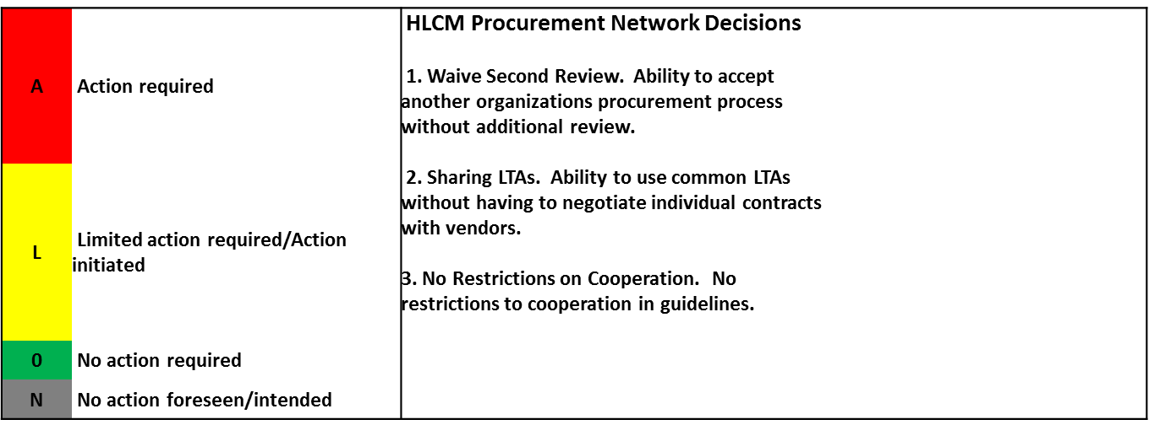
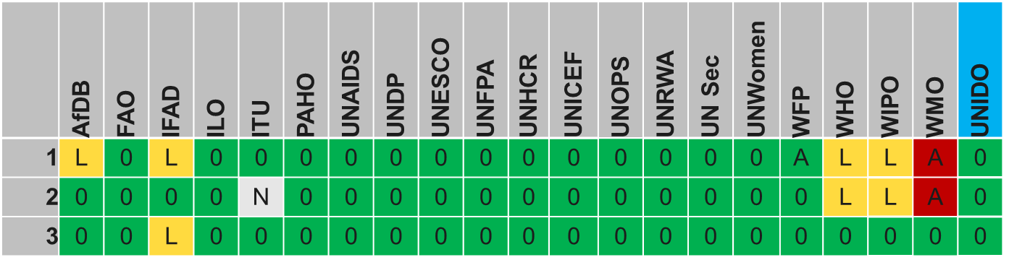
Example- what has been harmonized?
Procurement harmonization
Notes:
Message:
Harmonization at HQ has been progressing well:
For Procurement for example, most of the barriers with regards to individual agencies policies and procedures are removed for most agencies. There is no reason why collaborative procurmeent should not progress at country level. Yet this is still one of the main barriers agencies mention. This is likely due to a communication issue from HLCM/UNDG to country level.

Slide 5
Most popular CS (2016)
Notes:
Message:
This slide is illustrative, giving a sense what types of services OMTs work on at country level as of 2016.

Slide 6
Most Frequent Common Services 2014
Notes:
Message:
This slide shows the services with the highest frequency, e.g. most popular services at the country level
It leads into the next slide with the main message

Slide 7
Most Frequent Common Services 2014
Any analysis done?
Notes:
Message:
With the exception of Transportation Common Services, very little analysis is done with regards to costs and benefits prior to developing and implementing the service. The BOS aims to address this issue by providing a framework for better analysis, prioritization and management of common operations at country level.

Slide 8
Operationalization QCPR
Joint National/UN Steering Committee
One Leader (RC and UNCT)
Result Groups
OMT
Country CG
One Programme
Common Budgetary Framework
+ One UN Fund
Operating as One
Commun-icating as One
One annual UN Country Results Report (programme, funding, operations, communications)
Notes:
Message:
The UNDG SoPs are approved by 18 executive heads of the main agencies with a country presence.
The BOS is part of the UNDG Standard Operating Procedures for DaO (SoPs), more specifically, it forms the backbone of the Operating as One pillar of the SoPs.

Slide 9
UNDG BO work in focus
Strategic Planning
BOS
Bus Ops
Implementation
Standardized CS Packages
M&E
Harmonized M&E Framework- 2 core indicators
Lead Agency
Common Service Unit
Integrated Service Centers
Integrated work planning OMT
Governance
Common Funding
Common Report BO

Slide 10
HLCM-UNDG and the BOS
HLCM
Harmonised BO policies, procedures
Proc
ICT
HR
FIN
…
Data, Policy Input
UNDG
Country level solutions
BOS
UNCT
UNCT
UNCT
UNCT
UNCT
UNCT
UNCT
Notes:
Message:
The BoS operationalizes HLCM/UNDG harmonized policies, rules and regulations and “translates” these into country level solutions. As such it is the conduit for HLCM/UNDG to roll-out the newest innovations and changes in BO at the country level.
Added value BoS country level:
Reduced cost
Enhanced quality and access to services that would not be possible if agencies would develop these services just for themselves
State of the art Common Services based on the latest HLCM and UNDG products
Added value BoS for HLCM/UNDG/HQ
- vehicle to gather data and management information on impact and issues, bottlenecks at the country level that need to inform further harmonization and policy dialogue at UNDG,HLCM and agency HQ level.
- conduit for HLCM/UNDG to roll-out the newest innovations and changes in BO at the country level.

Slide 11
What is the BOS?
Derives from UNDAF/One Programme
Voluntary
Reflects only Common Operations
Same cycle as UNDAF
Medium Term strategic framework
Flexible and scalable to local need
Notes:
Key message: What is the BoS and what is it not. Stress the BoS will not replace agency operations, but rather complement agency business operations with those operations that are done jointly.
When explaining what the BoS is, draw the parallel to an “UNDAF for Business Operations”, but lighter in approach. Highlight it is based on the same RBM principles as the UNDAF (logframe, outcomes, outputs, indicators).
Components of the BoS:
Business Operations Results Framework, reflecting medium term outcomes and outputs in line with the UNDAF cycle;
Monitoring and Evaluation Framework, reflecting outcome and output level indicators allowing for progress monitoring and evaluation of impact of business operations;
Management Arrangements of UN Business Operations outlining the way the UN organizes itself in order to deliver cost effective operational support that meets UN Programme requirements;

Slide 12
Why do the BOS?
Enhanced linkages Programmes and Operations
Partially derives from UNDAF
Better match programme demand and service supply
Lower Operational Costs
Reduction of duplication of work processes;
Enhanced Management Control
Better Prioritization
Focused Investment time and money
Enhanced Quality of Business Operations
Enhanced Ability to Track and Report
Reduction of transaction costs;
Enhanced Management Information
Results beyond a single year
Service quality management
Access to services
Notes:
Key message: what are the intended results of the BoS.
Stress the enhanced linkage programmes and operations, which addresses a persistent issue with programmes and operations operating in silo’s at the country level.
Stress the potential to reduce cost of operations, something that the UN System is under heavy pressure for to do. Cost reduction examples include enhanced bargaining position and quantum discounts (larger volumes) and elimination of repetitive processes by executing together (saving labor time)
Enhanced linkages Programmes and Operations: The BoS has two components of operational support services - those deriving from UNDAF/programme and “ongoing operations” that do not derive directly from the programme. By analyzing the programme strategy through an operational lens and identifying the operations required to deliver the programme, the linkages between programme and operations are established. As both the UN Programme Strategy (UNDAF) and the Business Operations Strategy are on the same cycle, the development of the Business Operations Strategy enhances the linkages between the UNDAF and UN operations support to that programme strategy;
Reduced Costs: The BoS provides a strategic focus on operational support services and initiatives aimed at harmonizing and/or simplifying business operations. It allows for multi-year planning of operations and facilitates strategic planning of the operational effort. The suite of operational instruments it comes with allow for enhanced identification of cost benefits of different initiatives, allowing facts based decision making and prioritization. It also facilitates monitoring and evaluation of the operational effort at the country level. It focuses on reduced lead times to execute processes through streamlining operational process, and reduced direct monetary cost for example by leveraging UN System wide bargaining position when procuring goods and services. Anticipated cost reductions include:
Reduction of duplication of work processes at the agency level by providing the service through a single channel, rather than decentralized at the agency level (example ICT, Travel and building maintenance);
Reduction of transaction costs (time spent on activities) for the UN and partners, including the host government, due to harmonized operational procedures and standing agreements with vendors (e.g. VISA processes and Joint Long Term Agreements);
Enhanced leverage of UN bargaining position when procuring goods in larger quantities (ex. Office bulk goods, printing services).
Enhanced Quality: By jointly procuring services in larger volumes, the UN increases it bargaining power with the service provider and enhances its ability to monitor and evaluate overall quality of service delivery of that service provider.
Enhanced Operational Focus and prioritization: Instruments like Cost Benefit Analysis, Transaction Cost Analysis and Business Process Analysis provide light, easy to use tools to identify and prioritize high impact harmonization initiatives and facilitating monitoring and evaluation of harmonization initiatives against pre-established baselines.

Slide 13
What is the BOS?
UNCT
UNDAF
BoS = Scalable- Pick and chose service lines as locally needed
OMT
BoS
3-5 years
HR
Procurment
HR
Procurement
Finance
Finance
OMT
Task Teams
ICT
ICT
Logistics & Transport
Logistics & Transport
Finance
Facility Services
1 year
OMT Annual Work Plan Operations
Notes:
Message:
The BOS derives from the UNDAF
OMT is the main owener of the BOS, under delegated authority of the UNCT
BOS includes 6 service lines (areas under the BOS): Procurement, Finance, HR, ICT, Logistics, Facility Services
The OMT Annual Work Plans operationalize the BOS and must be linked to the BOS results, using the UNDG approved templates.

Slide 14
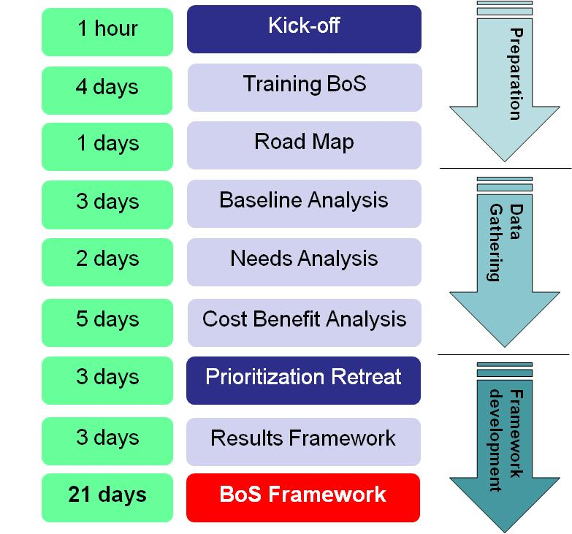
Milestones BOS Development
1 hour
4 days
2 weeks
Average Time
3 weeks
2 weeks
4 weeks
3 days
2 weeks
2 weeks
Notes:
The graphic show a “regular BoS approach. Actual time varies depending on the scope of the BoS.

Slide 15
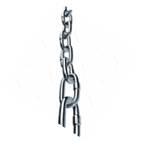


Why involve programme staff in ops?
UN development impact
PROGRAMME
Programme is the client- the programme is the reason operations exists.
DEMAND
OUR CHOICE:
Programme (to an extent) defines the nature and scope (demand) of operations
OR
OPERATIONS
Operations is the supplier- Operations is a key reason the programme can deliver
SUPPLY
The quality of operations support has a direct impact on the quality of programme implementation
Notes:
10 min
Message:
The overarching goal of the UN is deliver development assistance and to achieve impact on the quality of life of the people in the host countries.
In order to achieve this, establish the understanding that programme and operations are linked- both having their own role to play, but both influence the other to a great extent. Programme and Operations need to engage and help each other to deliver better.
For example:
The scale of the programme determines the scale of operations
The quality of operations (speed, meeting programme needs, cost) determine the quality of programme implementation
Frame it as a client-supplier relation. Quality management and client management are imperative for operations if we want to change the focus of operations from purely transactional, silo-ed approach to a dynamic, interactive quality of service type of approach. Programme needs often are very specific- operations staff need to understand this need to deliver a business operations service that helps programme achieve impact
The BOS helps develop and manage that relation by identifying programme needs for common operations and reinforce the understanding how operations and programme staff jointly are responsible to deliver programmes, each from their own skill set.

Slide 16

Key engagement points UNDAF-BOS
Objective: Align timelines UNDAF & BOS
Instrument: Draft roadmaps
Timing: at the outset of UNDAF/BOS development
Roadmap
Objective: Ensure UNDAF needs are covered in BOS
Instrument: Draft results frameworks UNDAF & BOS
Timing: Just before finalization results frameworks
Strategic Prioritization
Objective: Cross analyze issues in implementation progress
Instrument: Monitoring framework JAWP UNDAF and BOS
Timing: End of year
Annual Monitoring
Objective: Cross analyze issues in implementation progress & lessons learned for next cycle
Instrument: Evaluation Plan UNDAF and BOS
Timing: End of cycle
Evaluation
Notes:
10 min

Slide 17
Scoping the BoS
Flexibility- based on in country capacity and need, the UNCT/OMT can select multiple or just one outcome area (ex. Procurement);
Time Requirement: 3-6 months end-to-end over a 5 year cycle to develop the BoS, including analysis;
Time requirement may be higher or lower depending on the scope of the BoS (depends on capacity available and need);
Agencies participate in services as needed (opt in opt out).
Notes:
Message:
Stress the flexibility and the need to establish a scope for the BOS that local capacity realistically can manage.
Stress that even though agencies sign off on the BOS as a whole, agencies do not have to engage in all services under a BOS. Each service may have different agencies buying into them based o their local needs.

Slide 18
Light vs regular BOS
Baseline and Needs Analysis are mandatory
Cost Benefit Analysis
  Quantitative: more labor required, but more accurate
  Qualitative: Less labor required, but less accurate
  Suggested approach: Hybrid- use quantitative for select set of services (ex. Procurement)
Notes:
Message
If countries have low capacity they can do lighter BOS analysis. However, no steps of the BOS can be cut out as a whole.
Main difference between light and regular BOS sits in the way you do the Cost Benefit Analysis. The more you base the analysis on actual real data, the more labor intense the process becomes, but the better the data.
Its is a local decision for which services they want to do it quantitatively, and for which services they base themselves more on estimates (qualitative)
UNDG/DOCO recommends a hybrid approach with a more quantitative analysis for services requiring high investment in manpower or finances.

Slide 19
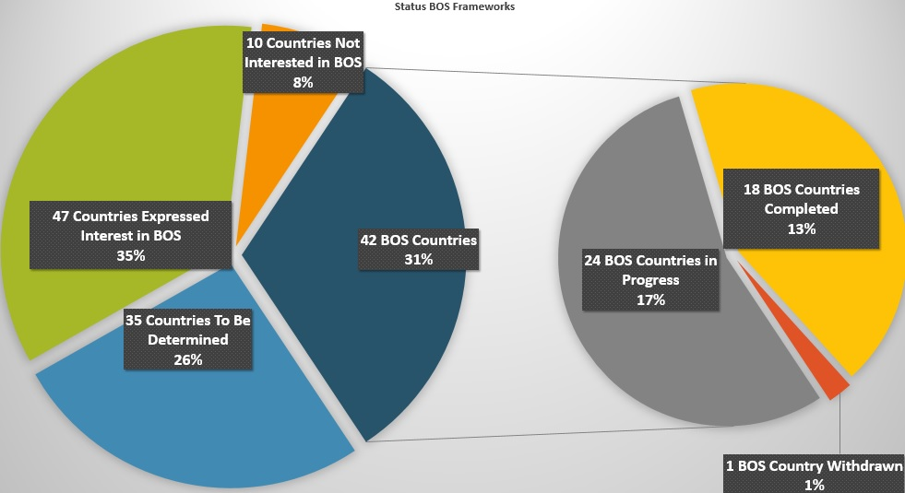
The BOS in the world (May 2016)
Notes:
59% of the UN System already has a BOS or is developing one
These numbers are increasing rapidly
Africa is the region with most BOS countries as of July 2015

Slide 20
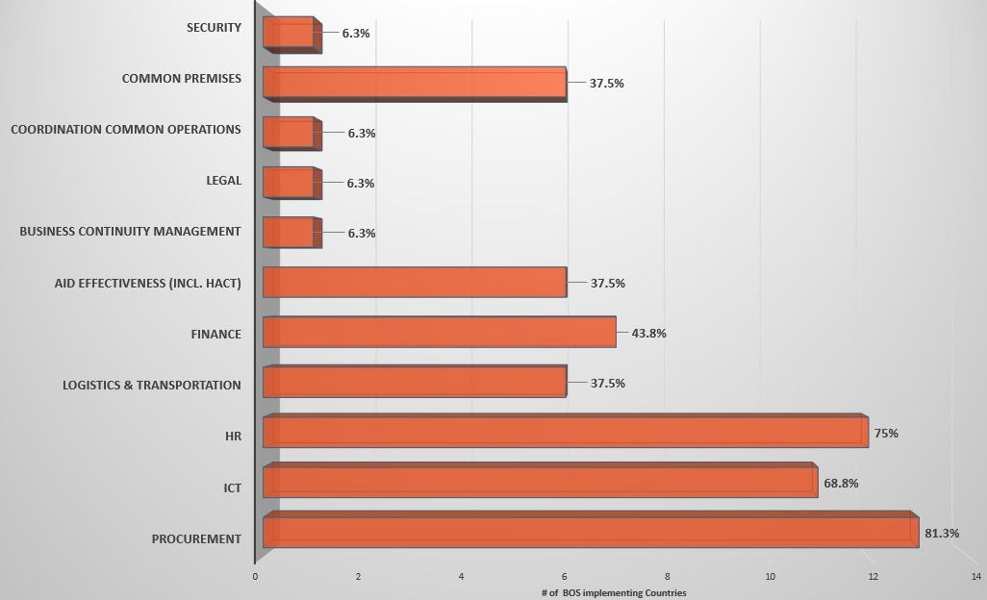
Most prevalent areas under BOS
Notes:
Procurement, HR and ICT are by far the most popular areas under the BOS

Slide 21
The benefit-cost¹ ratio - on average a USD 1 investment in Common Operations produced USD 4.67 in benefits
Global evaluation BOS: Impact
Note: Take care extrapolating
Only 5 countries in evaluation
Benefits are country dependent
Procurement benefit-cost ratio is greater with USD 1 producing benefits of USD 25
¹ Benefits include both monetary savings (e.g. bulk discounts from common procurement) and transaction costs avoided (labor savings)
,
Notes:
Message:
Procurement is a major source for cost reduction, even though other common services generate cost reductions as well, although at a lower level.
Stress that the assessment was done for a limited number of countries (5) in one specific region. Therefore these numbers cannot be scaled globally. But they indicate a trend, directional data suggesting a positive impact of common operations in terms of cost reductions.

Slide 22
Procurement benefits¹:
73% monetary cost savings stem from bulk discounts
27% transaction costs avoided
Global evaluation BOS:
Benefits of BOS
¹ No available data for Lesotho and for cost savings bulk discount, Tanzania
Notes:
Key message:
Transaction costs avoided is labor cost avoided- joint LTA for 15 agencies means 14 agencies do not have to establish a separate LTA. Labor cost is the largest cost component in the UN. LTA’s take 4-6 months to establish, which we avoid under an LTA (14x4-6 motnhs) which is a significant labor gain.
However, this graph shows countries do not include this labor gain as a benefit (ex. Ethiopia). This needs to change given the significant gain associated with LTA’s. You want to see a balance between the red and blue, with the red likely being larger as labor cost are the largest cost usually.

Slide 23
Global evaluation BOS:
Qualitative Benefits of BOS
Source- DESA QCPR Survey Jan 2016
Notes:
Message:
Apart from cost avoidance, the BOS equally aims to achieve qualitative gains, e.g. benefits that cannot be expressed in numbers.

Slide 24
Lessons Learned DaO
Leadership and champions are critical- consistency in commitment UNCT
Behavioral change takes time and needs attention- the Human Element- incremental change
Discipline is key- use of the new system, consistent communication
Realistic assessment of capacity translating to scaling of the strategy
Change best introduced when initiating a new cycle (UNDAF or BOS)
Enhanced strategic planning for BO
Workload balancing OMT
Enhanced monitoring and evaluation of impact BO
Notes:
This slide provides the timeframe of the development of the SOPs going from the World Summit 2005 to the HLP report on System Wide Coherence with the 8 pilots till the arrival of the QCPR and the SOPs.
It is important to underline that the QCPR gives intergovernmental recognition of the “Delivering as One” model for the first time, even though it remains a voluntary option. In addition to the development of an integrated package of support to DaO countries (standard operating procedures (SOPs) and DaO-specific guidance), there is also the request to identify and address challenges and bottlenecks at the HQ (and country) level. We will come back later to this further in the presentation.
While tools and guidance to further support the implementation of the SOPs are being developed, countries have been implementing elements of the SOPs using good practices/experiences from DaO countries. These tools and guidance are expected to be finalized and distributed to the UNCTs in the first quarter of 2014.

Slide 25
Challenges Common Operations
Source- DESA QCPR Survey Jan 2016
Notes:
Message:
This slide reflects the main challenges, as observed by OMTs. It helps to make UNCTs/OMTs aware of these challenges and plan for them and manage the risk coming with these challenges materialising.
Highlight the three biggest challenges

Slide 26
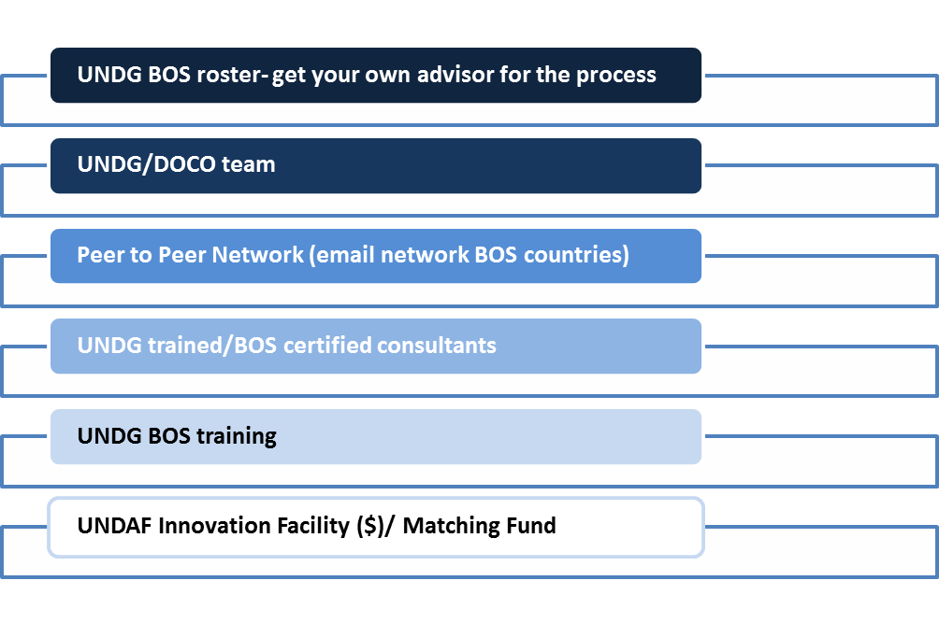
UNDG Support for BOS
Notes:
Message:
UNDG will support the UNCTs who want to move forward on the BOS. These are the BOS support structures in place for the countries.
They can be unlocked by the RC sending the UNCT approved roadmap with the BOS project timelines to the UNDG (ref next slide)

Slide 27
To unlock UNDG support…
RC submits UNCT approved Roadmap to the Director of DOCO
  Informing UNDG that the UNCT has decided to move forward on the BOS
  Kanni.wignaraja@undg.org
  Cc Chairs of UNDG Business Operations WG
    Jens Wandel: Jens.wandel@undg.org
    Jean Yves le Saux: jy.le-saux@unesco.org
  Cc Chairs of DOCO advisors to UNDG Bus Ops
    Lars.Tushuizen@undg.org
    Luigi.demunnik@undg.org

Slide 28
Support
UNDG Website:
https://undg.org/home/guidance-policies/business-operations/
UNDG/DOCO:
  Lars Tushuizen- lars.tushuizen@undg.org
  Business Operations Specialist
  Luigi de Munnik- luigi.demunnik@undg.org
  Business Operations Specialist
Notes:
Message:
The UNDG website was redesigned recently and has all the BOS resources on it: guidance, templates, examples, M&E guidance, tools, factsheets, FAQs

Slide 29
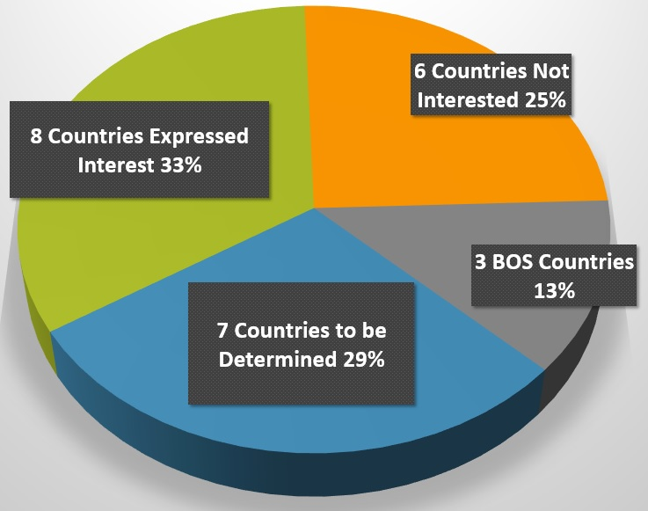
BOS in Asia Pacific

Slide 30
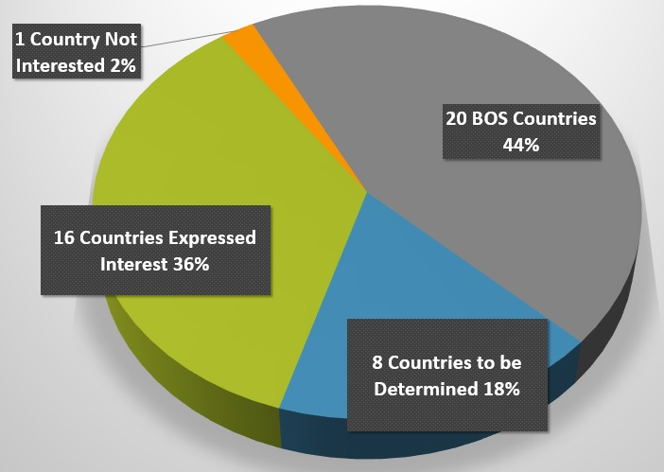
BOS in Africa

Slide 31
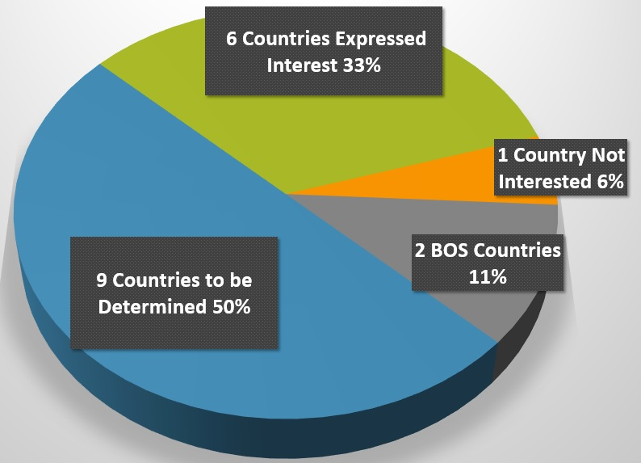
BOS in Arab States

Slide 32
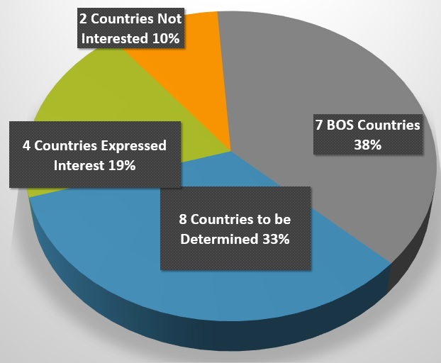
BOS in Europe/CIS

Slide 33
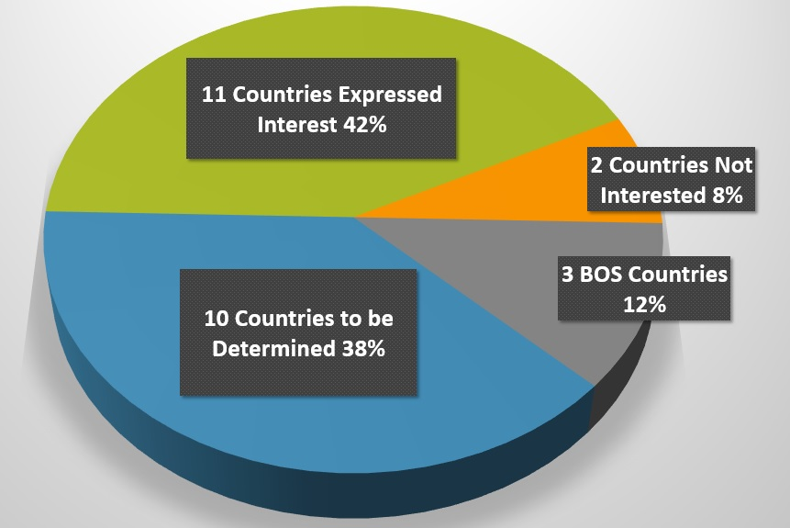
BOS in LAC

Slide 34

Milestones BOS Development

Slide 35
Governance of service delivery BOS
Lead Agency
Internal service provider
One Agency (supplier) to other agencies (clients)
Outsourced
One agency manages the contract
Requires min. supplier base in market
Integrated Service Center
Internal Service provider
Requires robust analysis and min. critical mass
Traditional model CS
External service provider
OMT led
Single service window
Dedicated unit proving services to client agencies

Slide 36
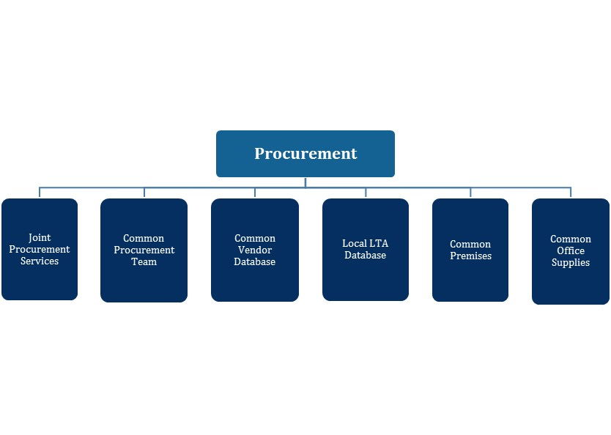
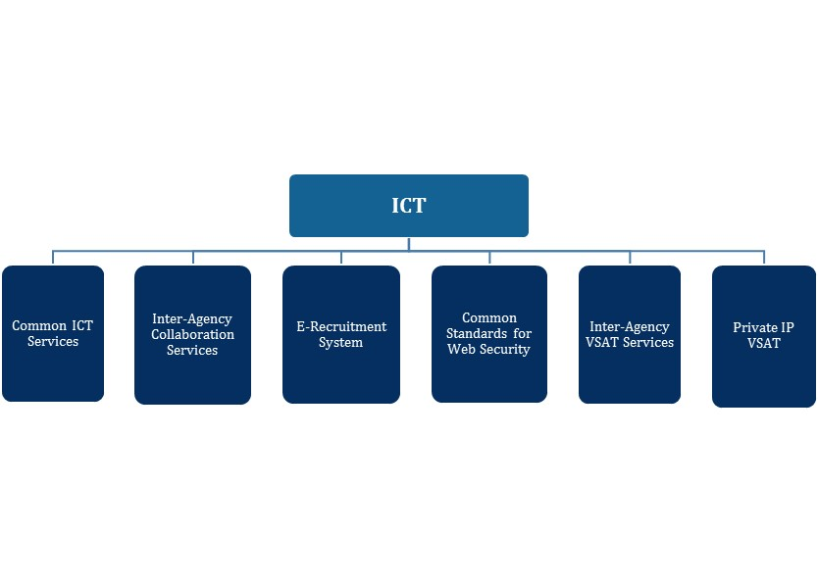
What’s Been Harmonized So Far?
Notes:
Procurement
Joint procurement services: Shared procurement service across UN agencies. It includes the use of shared premises or building. The objective of joint procurement is that participating agencies share the responsibility and decision-making; accountability and decision-making responsibilities are clearly assigned. In addition to that costs are shared among the participating organizations based on transparent, agreed drivers; and the most qualified staff member is selected for each position.
Common procurement team: 37 countries trained on common procurement
Common Vendor Database: UNGM web portal available for agencies procurement. UNGM has developed an LTA database where UN procurement staff can search for and register LTAs. It brings together more than 2500 UN procurement staff and the supplier community.
Local LTA database: LTA database for agencies sharing at the local level. Agencies on the field have the opportunity to share local LTAs.
Common premises: Use of one premise as a common UN house. Premises shared by UN organizations are an important component of the Secretary-general’s UN Reform Programme. The main objective of establishing and maintaining common premises, including UN Houses, is to co-locate UN organizations and all relevant inter-agency staff groupings, thereby creating a unified UN image, improving collaboration among UN organizations and achieving economies of scale. Common premises also support the cooperation of UN organizations in procurement.
Common Office Supplies: One supplier is selected by the OMT and each organization dealt with the supplier directly
ICT
Common ICT services: Use of shared ICT infrastructure such as common VSAT, radio and telecommunications, common domain & website across UN agencies
Inter-Agency Collaboration Services: It includes SharePoint, web conferencing, instant messaging shared video conferencing services
E-recruitment system: Use of a common website for recruitment across UN agencies
Common directory: This provides a searchable white pages directory service for United Nations staff. This service is only available to staff members of agencies that have had their global directories shared by agencies Headquarters in the common directory infrastructure.
Common standard for web security: Use of same software for web security across UN agencies
Common connect: Info sharing across agencies. UN employees and affiliates have the opportunity to access information concerning UN agencies.
Inter-Agency VSAT Services: This service refers to provision of corporate VSAT connectivity services from agency office to agency headquarters, and includes the last-mile connection from the VSAT point of presence(POP) of the VSAT hosting agency to the end-user agency.
Private IP VSAT: Private connectivity is a requirement for a number of UN agencies. UN VSAT providers have a shared UN VSAT design which offers various features such as private path for each agency, guaranteed capacity per agency, ability to burst to higher capacity if not used by other agencies and end to end quality of service for each agency’s applications.

Slide 37
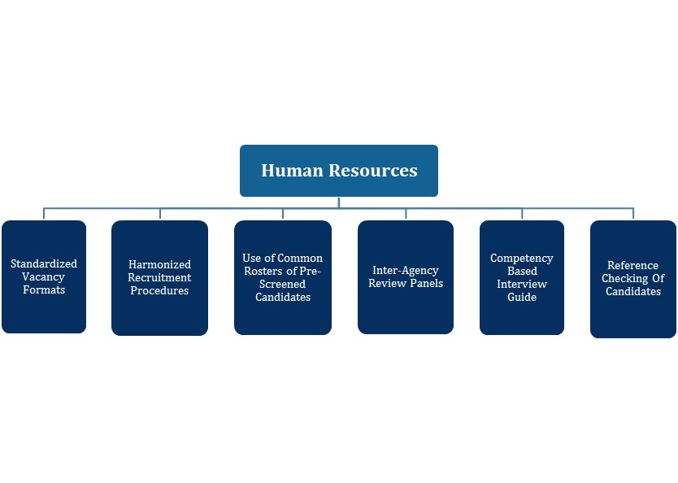
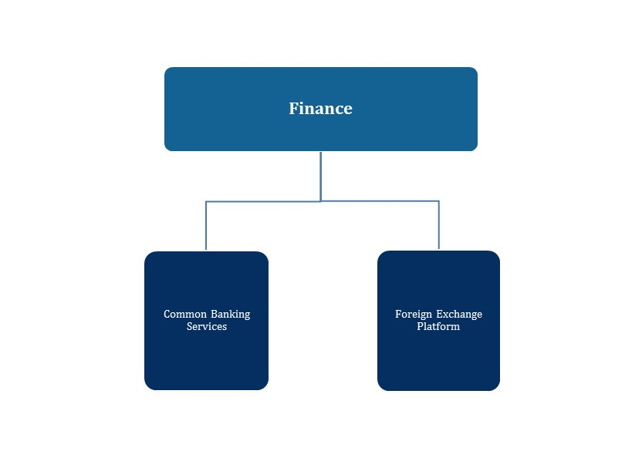
What’s Been Harmonized So Far?
Notes:
Human Resources
Harmonized recruitment for GS and NPO: The pilot project team has developed with the collaboration of all partners a harmonized recruitment model for locally recruited staff. Local agencies have adopted the same generic vacancy announcement.
Use of common rosters of pre-screened candidates: It consists of a list of candidates that have applied for typical posts in country offices after an external advertisement and have met the minimum requirement.
Inter-agency review panels: The use of inter-agency selection panels was incorporated as a key component based on the understanding that one of the main goals of this exercise is to foster a culture of teamwork among UN agencies. This practice is a trend in DaO countries and a widespread practice in both Uruguay and Vietnam. It entails delegation of authority to heads of Country Offices in order to ensure quality in recruitment operations as well as adherence to procedural requirement at the country level. The panel members should be drawn from a pool of members appointed for a one or two year period with a rotating chair of the panel. The recruiting agency should also be represented on the review panel. The panel should only have the ability to to review and comment on the process but not substitute the views of the selection panel on the merits of candidates.
Harmonized HR provisions: It helps to facilitate changes at agency HQs
Competency-based Interview Guide: In order to provide local partners with common selection tools, the project team prepared a Competency-Based Interview Guide that is available as a separate document. This guide is intended to foster common approaches to the selection process and improve the quality of recruitment operations. All agencies are invited to use it and undertake competency-based interviews as this emerged as good practice among agencies. Selection panel members will find in the Guide a detailed step-by-step explanation, some quick tips highlighted throughout the document, and a check-list at the end.
Reference checking of candidates: This includes written and oral checking as oral follow-up is very useful to verify if written references are accurate. Referees should include previous supervisors and the current one with the consent of the candidate.
Finance:
Common banking services: Five major banks are used globally (Barclays, Citibank, Ecobank, Standard Bank, Standard Chartered Bank. This Global Master Banking Agreements covers UN privileges and immunities and standardized pricing. 14 countries have banks that have been selected and 7 countries are expected to have a selection in 2015. USD RFP also completed with Bank of America, Citibank & Wells Fargo as the 3 recommended banks to provide banking services to the UN (contract negotiations under way). The progress includes the wide participation by Agencies and Country Offices in RFP process.
Foreign exchange platform: An annual FX study is done in which the results of the most recent year are discussed and best practices are shared. The current best practice is for the country offices to seek simultaneous FX quotes from eligible local dealers, and where possible, compare the best local rate to the rate offered by international FX dealers (obtained by HQ), and transact at the highest offer. The COs and HQs are also encouraged to regularly update the list of FX dealers that operate in the currencies they trade so that they can reap the most benefits from competitive pricing. As most emerging market currencies tend to devalue versus hard currencies (e.g. USD), the agencies may additionally consider converting smaller amounts more frequently to guard against the devaluation on idle foreign currencies held (case by case basis).
All emerging market currencies are included, noting that for some currencies (e.g. ETB) offshore pricing is not available and the trade must be done locally. To the best of my knowledge, the organizations are managing their FX transactions with the existing resources at the HQ and CO levels.
Developed market currencies are defined as CHF, DKK, EUR, GBP, JPY, KRW, NOK, NZD, SEK, SGD, and USD. Emerging market currencies are everything else. The developed market currencies are very liquid, and transactions between them are normally performed at HQ. Regardless, even if conversions between developed market currencies where to be done at the filed level, the same principle of comparing competitive quotes would apply.

Slide 38
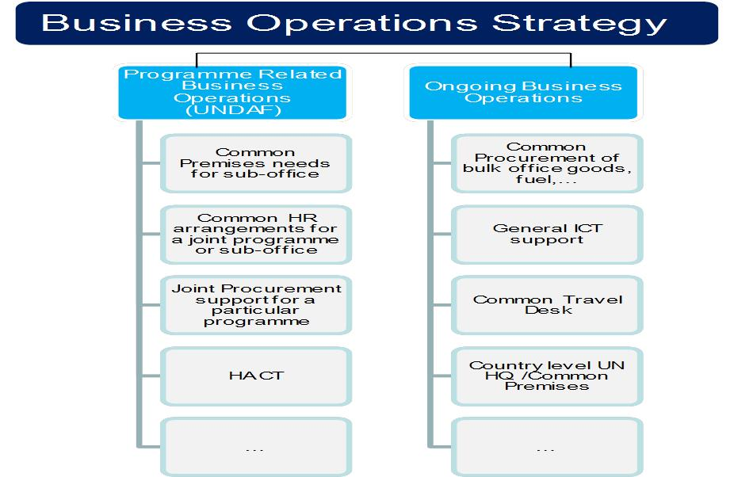
Link BOS- Programmes

Slide 39
Global evaluation BOS:
Relevance: Findings and Recommendations
Resource intensive nature of BOS
    Joint human resource needs for BOS implementation
Maintaining capacity – country level staff turn over
Findings
Consistency & Accountability needs
Reinvestment in joint Operations
Reinvest savings in common service budgets
Strengthen BOS Accountability Framework
Recommendations
Update UNDAF Guidelines
Sensitize Regional Level to BOS

Slide 40
Global evaluation BOS:
Efficiency: Findings and Recommendations
The qualitative benefits of BOS
    The business case to prioritize procurement
Monitoring BOS
Findings
Include coordination costs into planning to ensure proper budgeting and funding
Adapt HLCM cost categorization distinction for direct and indirect costs
Include BOS-related base indicators within IMS
Improve and harmonize data collection and monitoring tools, templates and processes
Improve CBA methodology and distinguish initial analysis for prioritization from evaluation
Agreements and principles of reciprocity
Recommendations
Focus on “Quick Wins” with guidance for implementing high impact procurement LTAs
Establish a base level of BOS deliverables required of all UNCTs
Comprehensively inform on the outcomes of the HLCM procurement project

Slide 41
Global evaluation BOS:
Effectiveness: Findings and Recommendations
MOU & SOPs to increase decision-making efficiencies
    Roles & Responsibilities – division of labour
BOS/UNDAF – operations/programmes connection
Challenges within current policy environment
Findings
￼
Maintaining momentum – incentives for BOS
￼
Importance of planning as a means to strengthen BOS
Support provided by UNDG/UNDOCO
Collaboration between operations and programmes
Developing MOUs and SOPs
Increase inter-regional and peer to peer exchange
Establishing incentive systems
Establish knowledge management system for BOS
Standardise monitoring and evaluation
Recommendations
Availability of Seed Funds
Maintain and expand Expert Roster
Clarify division of Labour
Study to identify barriers to BOS in agency business models
Deliver skills development for staff

Slide 42
Integrated Service Center
Brazil pilot

Slide 43
Some notes upfront
Brazil is a unique BOS pilot
No other BOS pilot are using the Integrated Service Center concept
No other ISC planned until assessment completed
Similar set-ups: Viet Nam, Copenhagen

Slide 44
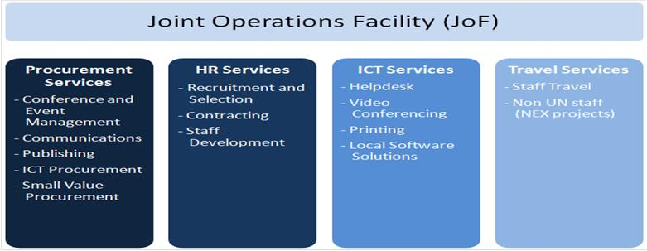
JOF Service lines
Eight participants
UNAIDS, UNDP, UNDSS, UNEP, UNESCO, UNFPA, UNOPS and UN Women.

Slide 45
Cost Benefit- Monetary & Labor

Slide 46
Brazil-Single Service Window
  Single rule set for clients- simplification, transparency
Single Service Window
  Cap. dedicated Common Operations- free up agency cap.
  Reduced cost ( leverage common volumes for services)
  Less process duplication (contract, client/supplier man
  Independent- Fair prioritization, accountability
Consolidation- No common operations outside the JoF
Supplements Agency, Regional and Global service models (different services)
Notes:
Single regulatory framework: The use of a harmonized rule set for clients instead of multiple rule sets means that process and transaction cost of doing business with the UN is reduced as it is easier and faster to get the operational support required. What is being done is more transparent as a result of this simplification into one single rule set.
Dedicated Capacity: The JOF manages processes that are transactional in nature, freeing agency operations staff up to focus on the more strategic components of relevance to the agencies’ mandate;
Reduced cost: Executing functions such as Procurement under a single service window for all participating agencies significantly reduces procurement or travel cost realized by leveraging joint United Nations volumes.
Less process duplication: Several agencies have functions that can be managed better and more cost-effectively by a single entity. One example is contract management. To date, not only has each agency managed its own individual contracts, but often they have been with the same suppliers. By combining this function under the JOF, dedicated attention is given to ensuring quality of service, more efficient contract management, better tracking of suppliers background and track records with the United Nations, while at the same time avoiding duplication of work.
Independent service: An independent governance structure, reporting to the JOSC rather than to a single agency head, promotes transparent, unbiased service delivery.
Specialization: Staff dedicated only to common operations will bring important learning effects, resulting in enhanced productivity and quality.

Slide 47
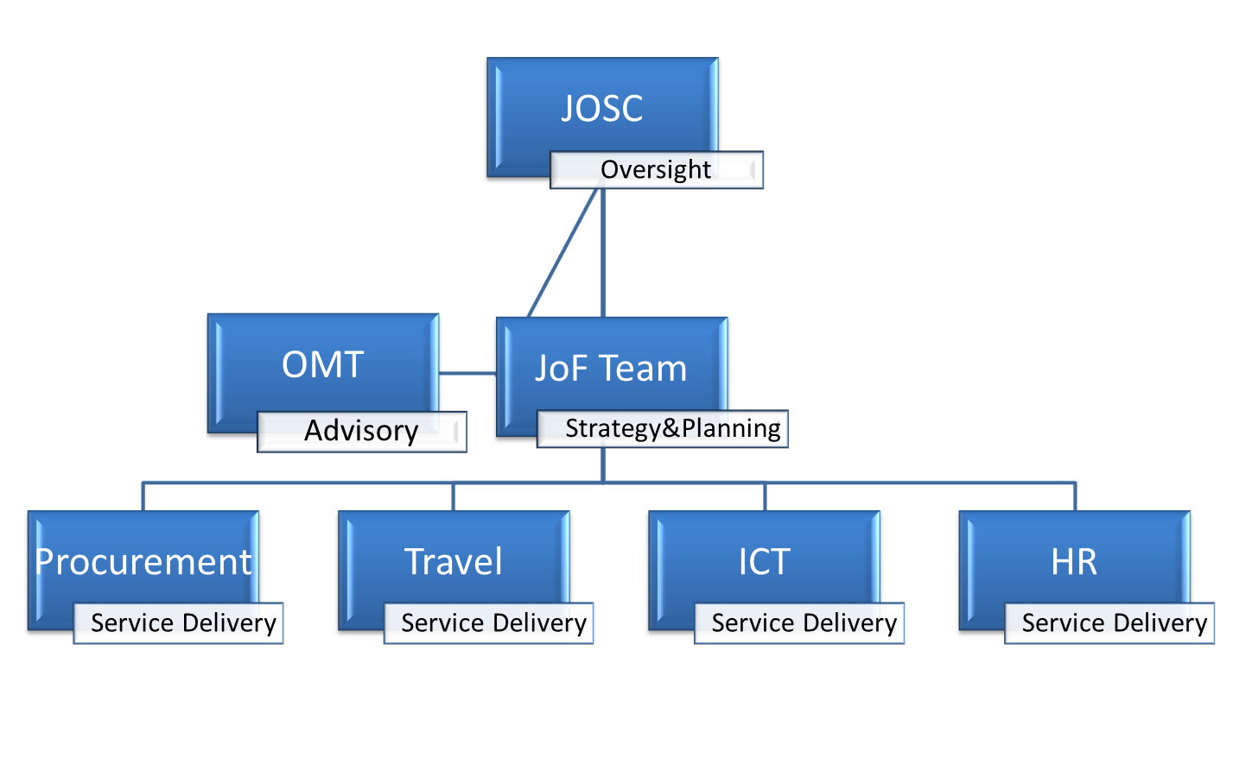
Brazil- Integrated Service Center
BOS
-- NOTE --
ISC NOT FOR ALL COUNTRIES
Brazil
Copenhagen
Viet Nam

Slide 48
Regulatory Framework
Notes:
The JOF will use a set of regulations, rules, policies, and procedures to manage and deliver services to its clients (both UN agencies and projects).
This regulatory framework consists first and foremost of harmonized solutions approved by inter-agency mechanisms and / or senior management. The JOF employs the latest innovations in the areas of HR, procurement, ICT and Travel, simplifying management structures and lowering transaction costs for clients.
The harmonized regulatory framework is supplemented by locally developed interagency procedures and processes which adhere to the general principles set by the relevant agencies’ rules and regulations.
Where harmonized solutions remain to be developed, the JOF uses the existing regulations, rules, policies and procedures of the administering agency. However, the JOF will have no direct reporting relation to the administering agency representative and instead will report to an interagency governing platform consisting of representatives of the partnering agencies to ensure its neutral position within the UN System in Brazil. The administering agency needs to have the space, processes, systems and capacity to be able to host the JOF. The JOF will have a service agreement (SLA) with the administering agency, with Service Level Agreements specifying cost recovery principles for internal JOF services.
For ease of reference, regulations, rules, policies and procedures are referred to as “regulatory framework".
Agency senior management needs to approve the local procedures and processes
In Brazil, the UNCT decided the agency administering the JOF is UNDP.
This means UNDP provides the space needed for the JOF as well as regulatory and administrative frameworks to function, e.g. a set of regulations, rules, and procedures, ERP and ICT systems, and legal arrangements that govern the JOF itself, as a unit. Some important distinctions need to be made in the context of the administering agency:
The administering agency has no control over the strategy, activities or any aspects of the JOF beyond providing administrative hosting services. The JOF reports only to the RC and the Joint Operations Steering Committee (ref section 3.1 Governance of the JOF);
The administering agency has not involved with service management or service delivery (whether the services are provided by the JOF, a lead agency or an external party).
The administering agency will facilitate JOF operations in terms of systems, space and other physical needs. The administering agency invoices the JOF for their hosting service.
Even though the JOF will use UNDP’s legal framework to manage its internal processes, the framework governing the service delivery by the JOF is not solely based on UNDP’s regulatory framework. Instead the JOF uses a set of harmonized policies and procedure as adopted in the relevant inter-agency mechanisms of the HLCM and the UNDG in each of the relevant service lines (Procurement, ICT, HR etc.) In addition, the Brazil UNCT develops a set of local procedures and processes guiding JOF service delivery (for example the Brazil local procurement manual).

Slide 49
But do they do anything at HQ?

Slide 50
Status of implementation of Procurement Network recommendations (2011, BASELINE)
Legend:
A
Action required
1
UN Cooperation
5
Procurement services
L
Limited action required / initiated
2
Second review
6
Integration of ‘guidelines‘
0
No action required
3
LTAs
7
Communication on ‘guidelines‘
N
No action foreseen / intended
4
Restrictions
8
Table of Contents
 | AfDB | FAO | IFAD | ILO | ITU | PAHO | UNDP | UNFPA | UNHCR | UNICEF | UNOPS | UNRWA | UN Sec | WFP | WHO | WIPO | WMO
1 | L | 0 | L | N | A | A | A | L | A | A | L | L | 0 | A | A | A | A
2 | A | 0 | A | N | A | A | A | 0 | 0 | 0 | 0 | 0 | A | A | A | A | A
3 | A | 0 | 0 | N | 0 | A | A | 0 | 0 | 0 | 0 | 0 | 0 | 0 | A | A | A
4 | 0 | 0 | 0 | A | 0 | 0 | 0 | 0 | 0 | 0 | 0 | 0 | A | 0 | 0 | 0 | 0
5 | A | 0 | A | N | A | A | A | 0 | A | 0 | 0 | A | N | A | A | N | N
6 | A | A | A | A | A | A | A | A | A | A | A | A | A | A | A | A | A
7 | A | A | A | A | A | A | A | A | A | A | A | A | A | A | A | A | A
8 | A | A | A | A | A | A | A | L | A | A | A | A | A | L | A | A | A
Notes:
DISCUSSION: Are there any further updates which you would like report regarding your organization?

Slide 51
Status of implementation of Procurement Network recommendations (Sep 2012)
Legend:
A
Action required
1
UN Cooperation
5
Procurement services
L
Limited action required / initiated
2
Second review
6
Integration of ‘guidelines‘
0
No action required
3
LTAs
7
Communication on ‘guidelines‘
N
No action foreseen / intended
4
Restrictions
8
Table of Contents
 | AfDB | FAO | IFAD | ILO | ITU | PAHO | UNDP | UNFPA | UNHCR | UNICEF | UNOPS | UNRWA | UN Sec | WFP | WHO | WIPO | WMO
1 | L | 0 | L | L | A | L | L | 0 | A | 0 | L | L | 0 | L | A | A | A
2 | A | 0 | A | L | A | 0 | L | 0 | 0 | 0 | 0 | 0 | 0 | A | A | A | A
3 | L | 0 | 0 | L | A | 0 | L | 0 | 0 | 0 | 0 | 0 | 0 | 0 | A | A | A
4 | 0 | 0 | L | L | 0 | 0 | 0 | 0 | 0 | 0 | 0 | 0 | 0 | 0 | 0 | 0 | 0
5 | L | N | N | L | A | L | L | 0 | L | 0 | 0 | A | N | L | A | N | N
6 | A | A | A | L | A | L | L | 0 | A | 0 | A | A | N | A | A | A | A
7 | A | A | A | L | A | L | L | 0 | L | 0 | A | A | N | A | A | A | A
8 | A | A | L | L | N | A | L | 0 | L | A | A | A | A | L | A | A | A
Notes:
DISCUSSION: Are there any further updates which you would like report regarding your organization?

Slide 52
Status of implementation of Procurement Network recommendations (Sep 2013)
Legend:
A
Action required
1
UN Cooperation
5
Procurement services
L
Limited action required / initiated
2
Second review
6
Integration of ‘guidelines‘
0
No action required
3
LTAs
7
Communication on ‘guidelines‘
N
No action foreseen / intended
4
Restrictions
8
Table of Contents
 | AfDB | FAO | IFAD | ILO | ITU | PAHO | UNDP | UNFPA | UNHCR | UNICEF | UNOPS | UNRWA | UN Sec | WFP | WHO | WIPO | WMO
1 | 0 | 0 | L | L | N | L | L | 0 | L | 0 | L | L | 0 | L | A | L | A
2 | N | 0 | A | L | 0 | 0 | 0 | 0 | 0 | 0 | 0 | 0 | 0 | A | A | N | A
3 | 0 | 0 | 0 | L | N | 0 | 0 | 0 | 0 | 0 | 0 | 0 | 0 | 0 | A | L | A
4 | 0 | 0 | L | L | 0 | 0 | 0 | 0 | 0 | 0 | 0 | 0 | 0 | 0 | 0 | 0 | 0
5 | N | 0 | N | L | N | L | L | 0 | 0 | 0 | 0 | A | N | L | A | L | N
6 | N | L | A | L | N | L | L | 0 | A | 0 | A | A | N | A | A | N | A
7 | N | 0 | A | L | N | L | L | 0 | 0 | 0 | A | A | N | A | A | N | A
8 | N | A | L | L | N | A | L | 0 | L | A | L | A | A | L | A | L | A
Notes:
DISCUSSION: Are there any further updates which you would like report regarding your organization?

Slide 53
Status of implementation of Procurement Network Recommendations (January, 2014)
Legend:
A
Action required
1
UN Cooperation
5
Procurement services
L
Limited action required / initiated
2
Second review
6
Integration of ‘guidelines‘
0
No action required
3
LTAs
7
Communication on ‘guidelines‘
N
No action foreseen / intended
4
Restrictions
8
Table of Contents
 | AfDB | FAO | IFAD | ILO | ITU | PAHO | UNAIDS | UNDP | UNESCO | UNFPA | UNHCR | UNICEF | UNOPS | UNRWA | UN Sec | UNWomen | WFP | WHO | WIPO | WMO
1 | 0 | 0 | L | L | N | L | L | L | 0 | 0 | L | 0 | 0 | L | 0 | 0 | L | A | L | A
2 | N | 0 | L | L | 0 | 0 | N | 0 | 0 | 0 | 0 | 0 | 0 | 0 | 0 | 0 | A | A | N | A
3 | 0 | 0 | 0 | L | N | 0 | L | 0 | 0 | 0 | 0 | 0 | 0 | 0 | 0 | 0 | 0 | A | L | A
4 | 0 | 0 | L | L | 0 | 0 | L | 0 | 0 | 0 | 0 | 0 | 0 | 0 | 0 | 0 | 0 | 0 | 0 | 0
5 | N | 0 | L | L | N | L | N | L | N | 0 | 0 | 0 | 0 | A | N | L | L | A | L | N
6 | N | 0 | L | L | N | 0 | L | L | 0 | 0 | A | 0 | L | A | N | 0 | A | A | N | A
7 | N | 0 | L | L | N | 0 | L | L | 0 | 0 | 0 | 0 | 0 | A | N | 0 | A | A | N | A
8 | N | L | L | L | N | 0 | L | L | L | 0 | L | A | 0 | A | A | 0 | L | A | L | A
Newly joined agencies
Notes:
DISCUSSION: Are there any further updates which you would like report regarding your organization?

Slide 54
Status of implementation of Procurement Network recommendations (September, 2014)
A | Action required | 1. UN Cooperation | 5. Procurement Services | 9. Common Glossary of Terms
L | Limited action required/Action initiated | 2. Waive Second Review | 6. Integration of "guidelines"
0 | No action required | 3. Sharing LTAs | 7. Communication on "guidelines"
N | No action foreseen/intended | 4. No Restrictions | 8. Table of Contents
 | AfDB | FAO | IFAD | ILO | ITU | PAHO | UNAIDS | UNDP | UNESCO | UNFPA | UNHCR | UNICEF | UNOPS | UNRWA | UN Sec | UNWomen | WFP | WHO | WIPO | WMO | UNIDO
1 | 0 | 0 | L | 0 | N | L | L | 0 | 0 | 0 | L | 0 | 0 | L | 0 | 0 | L | L | L | A | 0
2 | L | 0 | L | 0 | 0 | 0 | N | 0 | 0 | 0 | 0 | 0 | 0 | 0 | 0 | 0 | A | L | L | A | 0
3 | 0 | 0 | 0 | 0 | N | 0 | L | 0 | 0 | 0 | 0 | 0 | 0 | 0 | 0 | 0 | 0 | L | L | A | 0
4 | 0 | 0 | L | 0 | 0 | 0 | L | 0 | 0 | 0 | 0 | 0 | 0 | 0 | 0 | 0 | 0 | 0 | 0 | 0 | 0
5 | N | 0 | L | 0 | N | L | N | 0 | N | 0 | 0 | 0 | 0 | L | N | 0 | L | 0 | L | N | 0
6 | N | 0 | L | 0 | N | 0 | L | 0 | 0 | 0 | A | 0 | 0 | L | N | L | A | L | 0 | A | L
7 | N | 0 | L | 0 | N | 0 | L | L | 0 | 0 | 0 | 0 | 0 | L | N | L | A | L | 0 | A | L
8 | N | L | L | 0 | N | 0 | L | 0 | L | 0 | L | L | 0 | L | A | 0 | L | L | L | A | A
9 |  | L | L | 0 |  | A |  |  | L | L | L | L | 0 | L | L | 0 |  | 0 |  | A
Newly joined agencies
Notes:
DISCUSSION: Are there any further updates which you would like report regarding your organization?

